Slide 1
How to 3D Print a CAD Format Part
(Autodesk Ultimaker Cura)
Ethan Hall

Slide 2
Something to note:
Ender 3 v2 Printer
Ultimaker Cura software
Autodesk Inventor software
Resources used
Each step in this presentation is specific to these resources

Slide 3
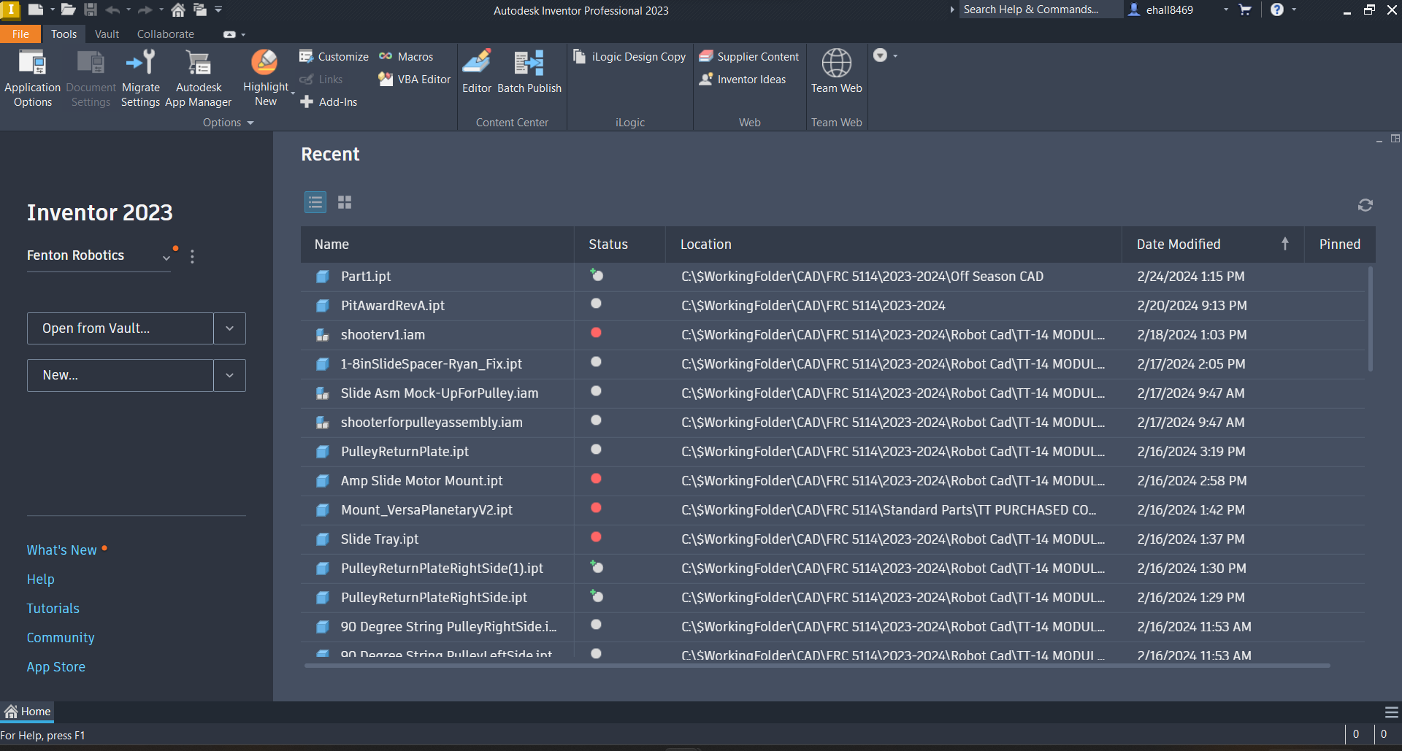

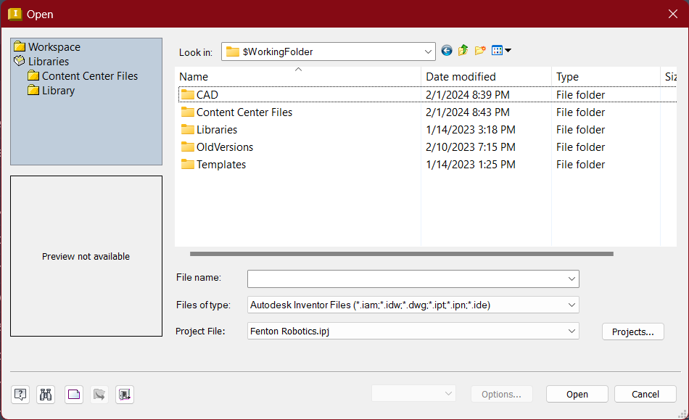
Step 1: Opening your part (Autodesk)
To open a part, go to the Inventor tab. Make sure your Inventor looks like this:
Next, click the button toward the left hand side of the screen.
If you have Inventor Vault installed and logged in, you will see a button that says . Be sure to click the drop down arrow next to this button in order to display the button. After this you will see a file explorer window pop up, it should look like this:
Click the part you would like to open. Make sure “Files of type” is set to “Autodesk Inventor Files”.
Note: The recommended file type is .ipt (part file).

Slide 4
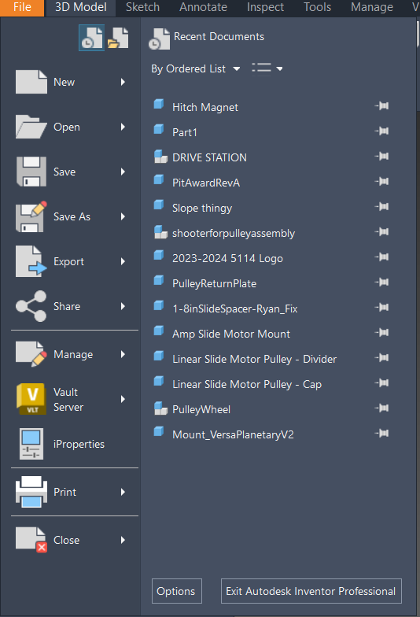
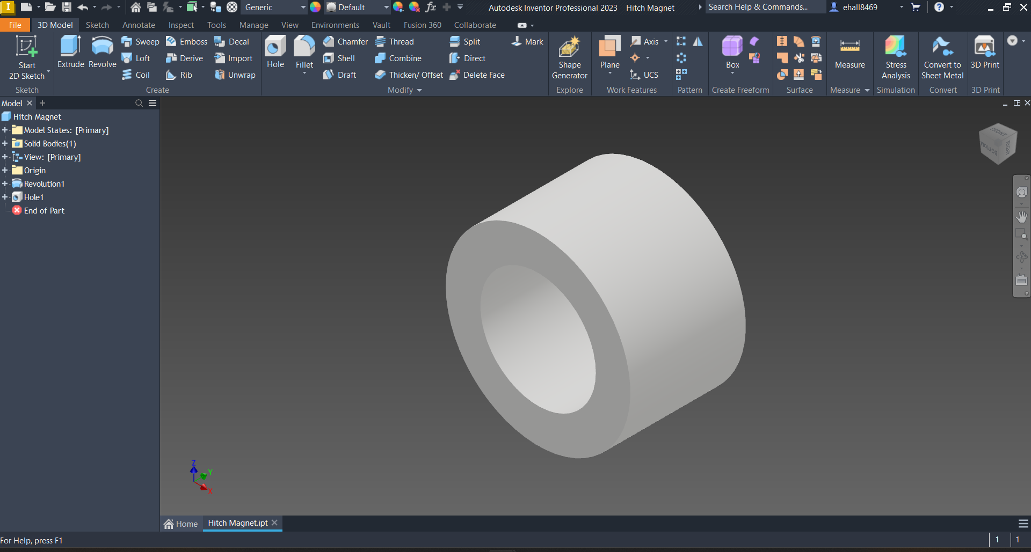
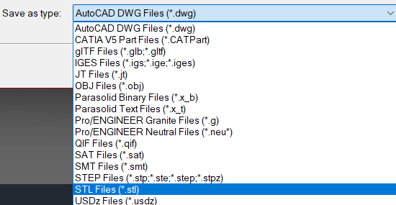


Step 2: Export your part as a 3D Print file
After opening your desired part, you should see a screen similar to this:
Now you are going to export your part. To do this, hit in the top left corner of your screen. The drop down menu will look like this:
Click , then click . Set “Save as type’” to STL.

Slide 5

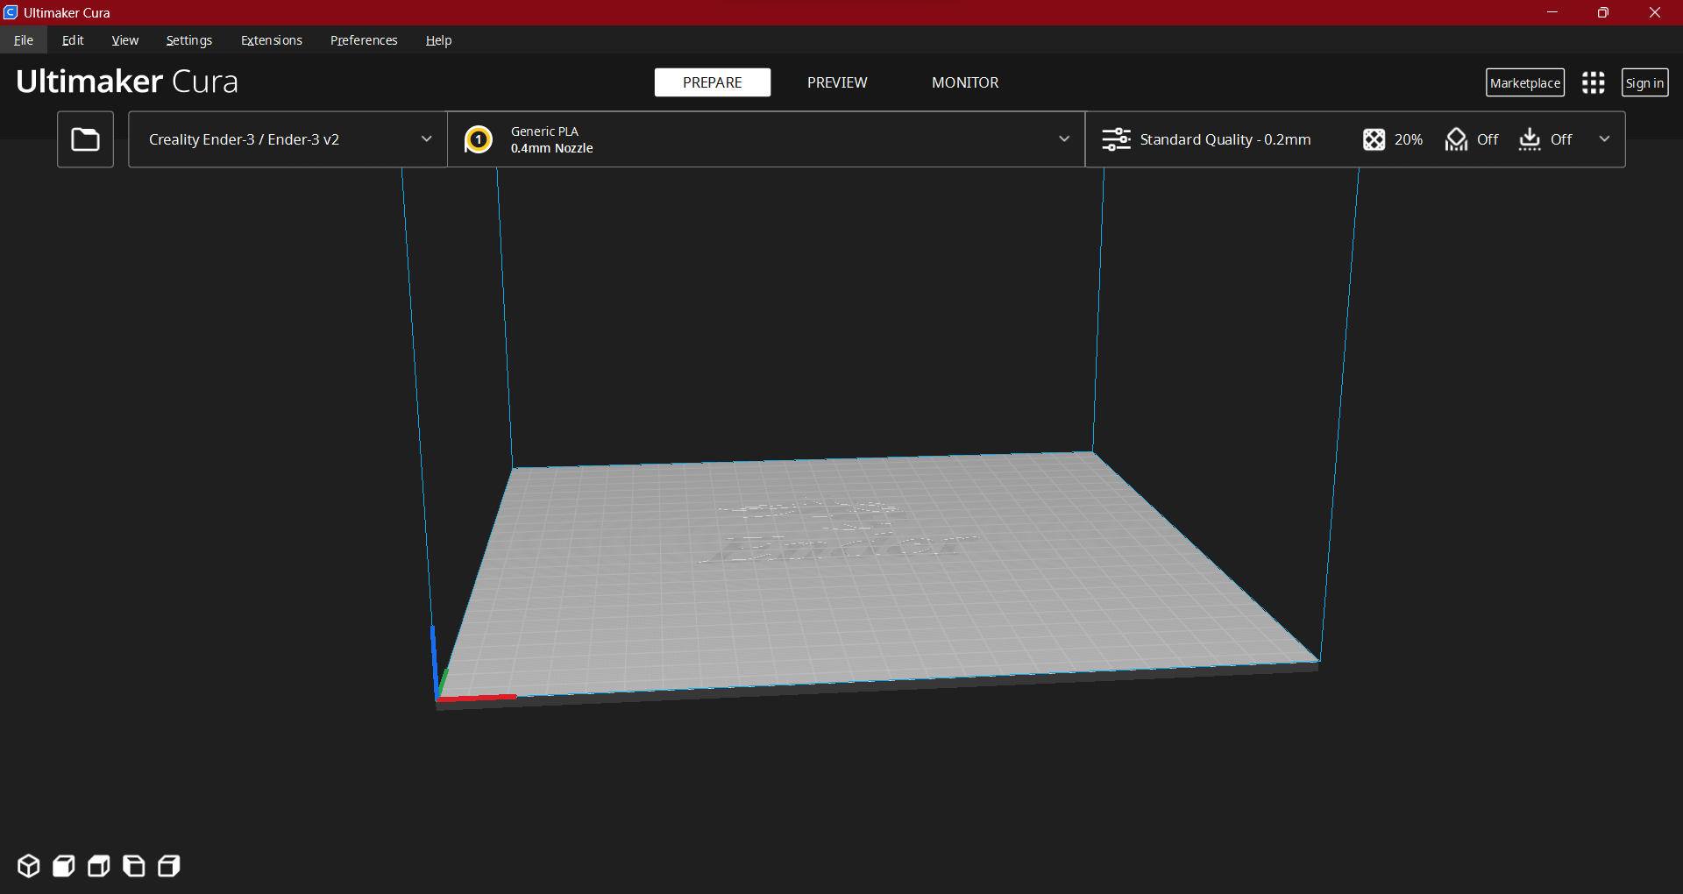
Step 3: Opening the STL in Ultimaker Cura
Start by opening the Ultimaker Cura application. It should look similar to this depending on the version you are using:
Click on the button toward the top left hand corner of the
screen. Another file explorer window will pop up. Find your part
in the folder you saved it in. Make sure you are searching for
STL files.
Once you open your part you will see it on the bed plate (set
your printer if you have not done that already).

Slide 6
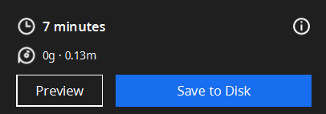

Part 3: Cont’d.
Next hit the button in the bottom right
corner of the screen. After this you will see a menu take its place.
The contents of the print (time, material, etc.) will differ depending on
your print size, shape, quantity, etc. There will also be an option to preview your print. You can preview the different layers, and the way that the part will be printed. In this mode you can also view where supports will lie, if you have supports turned on. Now click the button that appears within this menu. This blue button may also say “Save to Removable Disk” if you have a USB stick plugged into your computer.

Slide 7
Step 4: Print on your 3D Printer
Now all you need to do is load the file onto your printer. That’s it. Hit print and watch your part come to life.

