Slide 1
How-To Buttons
In 4 Easy Steps

Slide 2
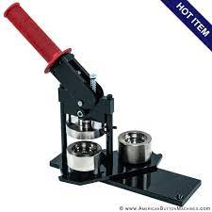
Step 1
Grab Button Maker machine
For Example: This one
Differentiate the two platforms
-shallow inset rim
-deep inset

Slide 3
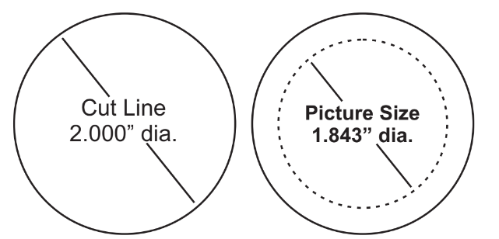
Step 2
Place metal shell in shallow rim
Place paper cutout on the metal shell
Place clear plastic on picture
Place pin backing on deep inset side

Slide 4
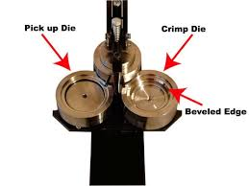
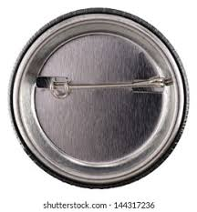
*NOTE*
*Ensure pinned back and picture face the same direction* on machine

Slide 5
Step 3
Turn shallow rim under crimp vise
Pull down lever all the way and back up
*Metal shell, picture, and plastic will be inside clamp*

Slide 6
Step 4
Turn deep rim under clamp
Clamp down, then lift up

Slide 7

You’re Done!

